Slide 1


Risk Analysis and Support System for Children with ASD Using IoT
Presented by
Susmita Debnath
191002076
Tahiya Akter
191002213
Shartaz Yeasar Feeham
191002130
Supervised by
Md. Solaiman Mia
Assistant Professor
Department of CSE
Green University of Bangladesh

Slide 2
Introduction
Tools and technologies
Motivation
Data collection
Contents
Objectives
Evaluation
Literature Review
Limitations and challenges
Problem Description
Future work
Methodology
Conclusion

Slide 3

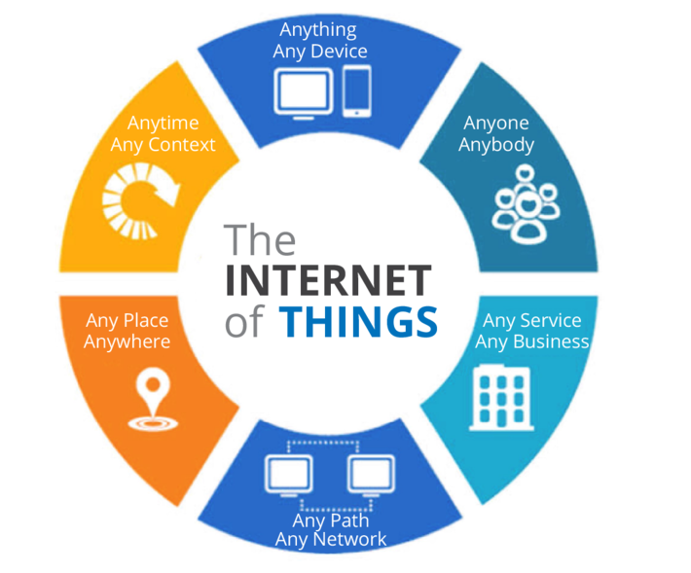
INTRODUCTION
Autism Spectrum Disorder (ASD) is a medical condition that occurs in children which affects communication and behavior of a kid.
Internet of Things (IoT) is simply a network of “things” that are connected to the internet so they can share data with each other.

Slide 4
MOTIVATIONS
Acquiring knowledge
Assuring safety
High availability of IoT
Contribute for health sector
IoT’s previous success

Slide 5
OBJECTIVES
Aims for observing and analyzing risk
To examine the extent, range, and efficiency of IoT
To make risk detection algorithms reliable.
Propose a protection device model

Slide 6
PROBLEM DESCRIPTION
Autism children deserve to be observed without being treated like they are caged.
For being not observed they are getting in risk.
For being over observed they are being caged.
IoT has a big role in healthcare but not enough in this field.
The problem
Why
is it
What can not be done
What can be done
Real time monitoring
Capturing risks from surrounding environment or movements
Limited range.
Can catch up certain situations only.

Slide 7
LITERATURE REVIEW
Title | Brief | Pros | Cons
Autism Support System using RFID Technology [1] | Identifies the location of ASD child and informs parents using RFID. | Common technology, low cost, available tools. | Backdated GSM, low range, RFID can only detect physical scenarios.
A support system for autistic children using Internet of Things technology [2] | Uses advanced computing device and multiple sensors to observe the children and acknowledge parents. | WIFI for communication, Several risk detection, calming section. | Complex implementation, large device, internet dependency.

Slide 8
LITERATURE REVIEW
Title | Brief | Pros | Cons
Emotion Recognition of Autism Children Using IoT [3] | Use thermal infrared (IR) information as data to detect the facial expression of ASD child and analyze their status. | User friendly, effective in mental and social risk/problem detection, doesn’t use multiple sensors. | Some ASD child make abnormal facial expressions.
Role of IoT and ML for autistic people [4] | A comparative study about the various systems currently being used for monitoring the autistic patients’ and how can those be efficiently applied. | Polysomnography, pulse rate sensor, eye tracking glasses. | Some proposed applications are sensitive, stationary and inefficient

Slide 9
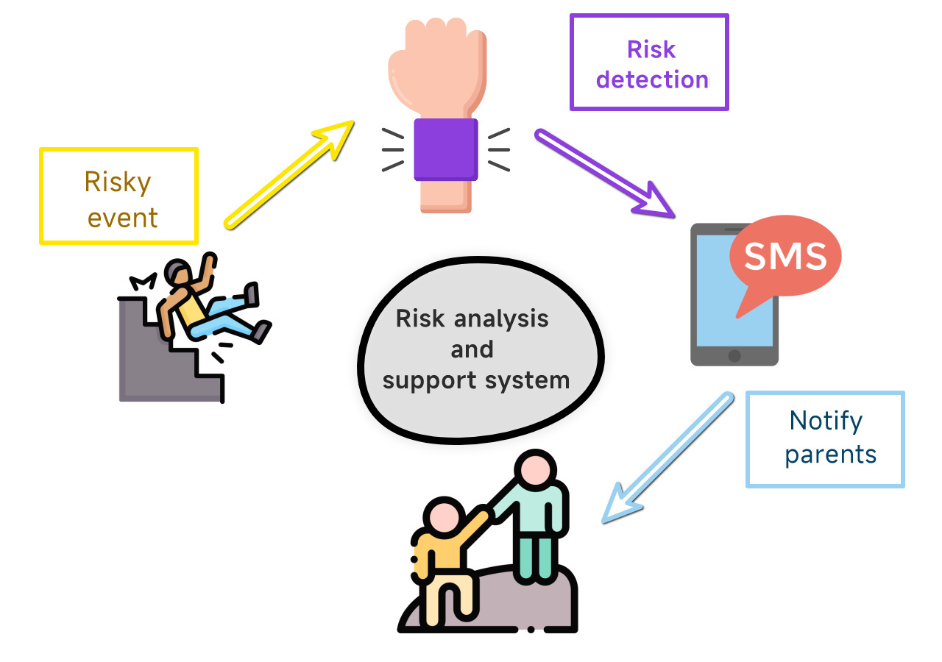
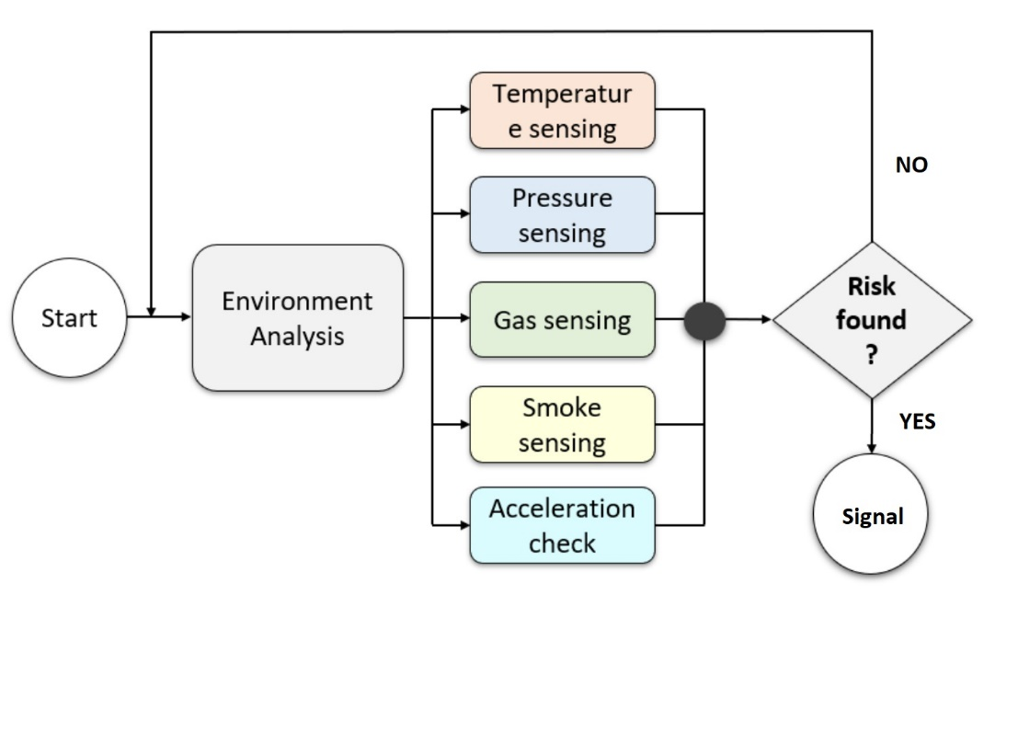
METHODOLOGY (SYSTEM FLOW AND ENGINEERING PROCESS)

Slide 10
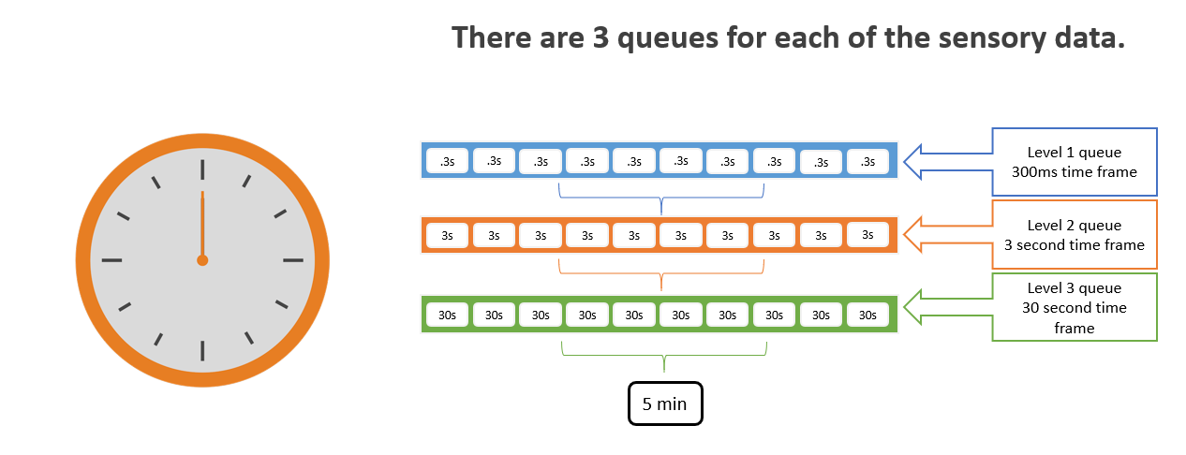
METHODOLOGY (SYSTEM FLOW AND ENGINEERING PROCESS)

Slide 11
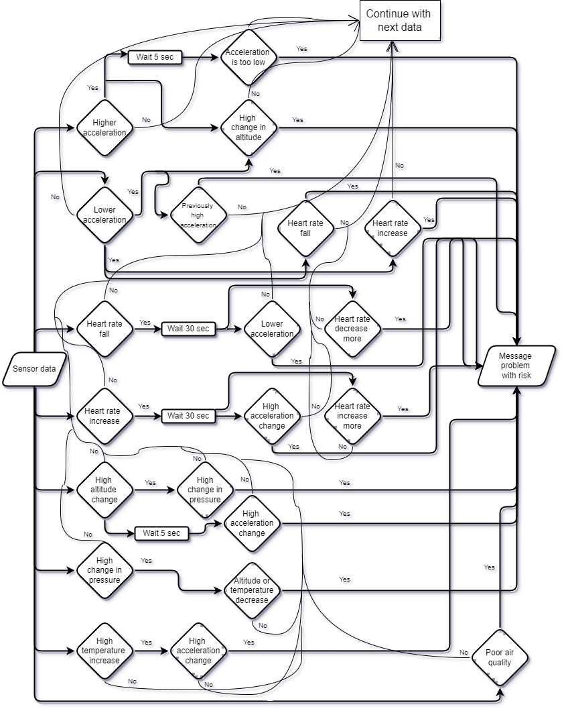
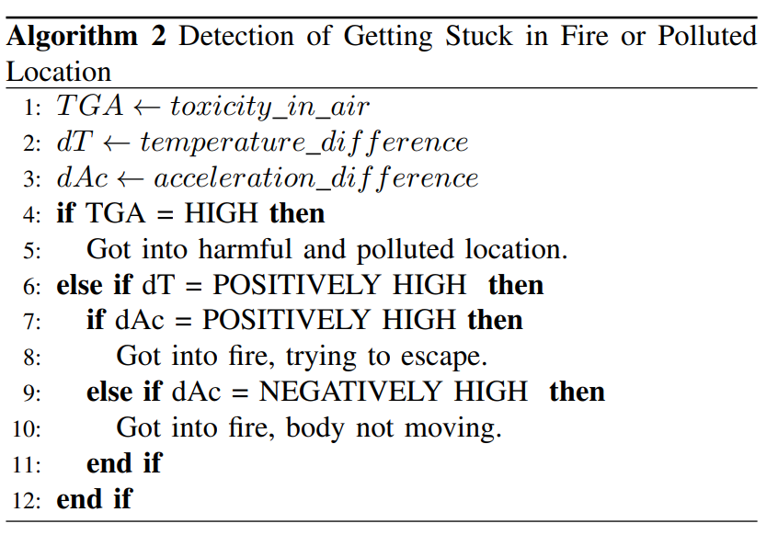
METHODOLOGY (ALGORITHMS)
The system uses the data in real-life logical conditions to determine a state. There are 5 different algorithms that handles a dozen types of input data; each one is connected with others’ yet independent. A cooperative flow shown here, is the backbone of the system.

Slide 12
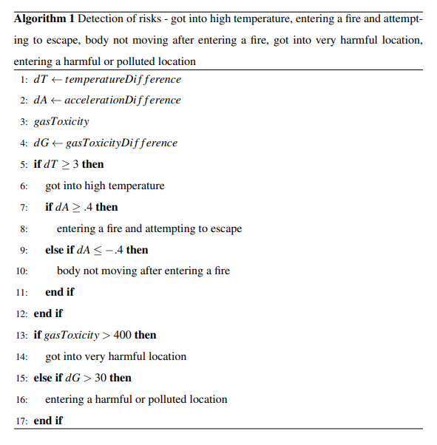
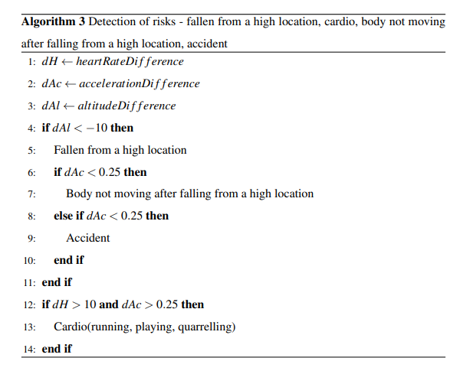
METHODOLOGY (ALGORITHMS)

Slide 13
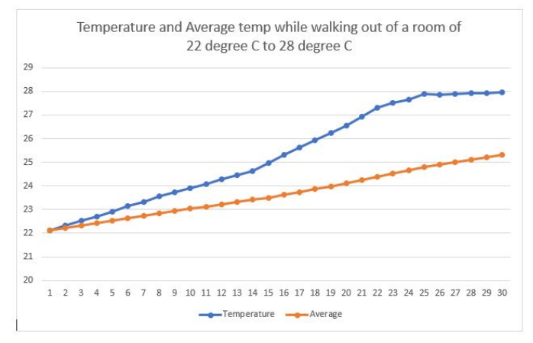
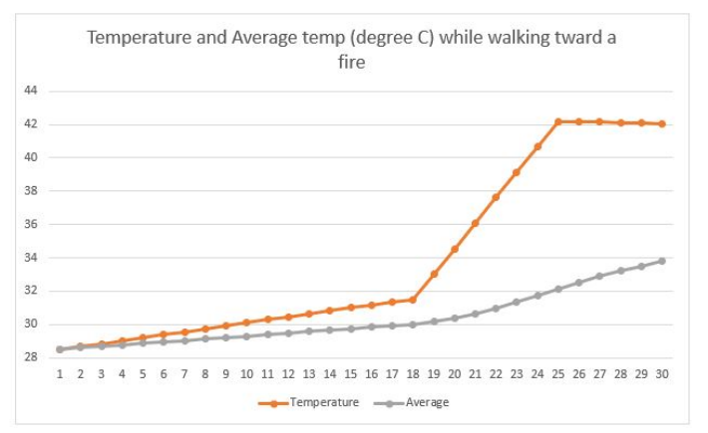
METHODOLOGY (THRESHOLDS)
To figure out different threshold values, we conducted several experiments for each of the input data. The experiments are divided into two different types.
Regular events: Experimented on regular environments and surroundings to observe what the data looks in no-risk situation.
Risky events: Experimented on risky environments and surroundings to observe what the data looks in risky situation.

Slide 14
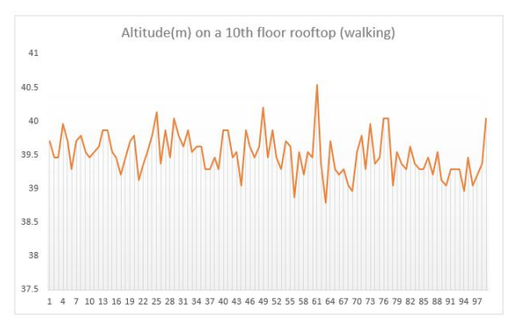
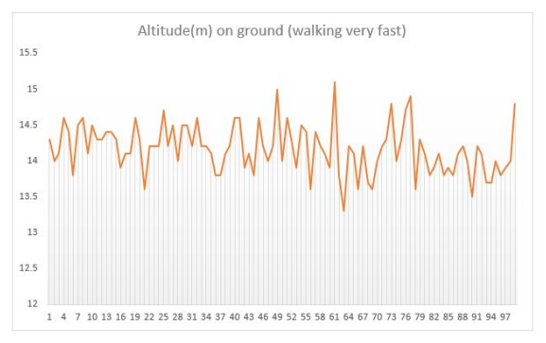
METHODOLOGY (THRESHOLDS)

Slide 15
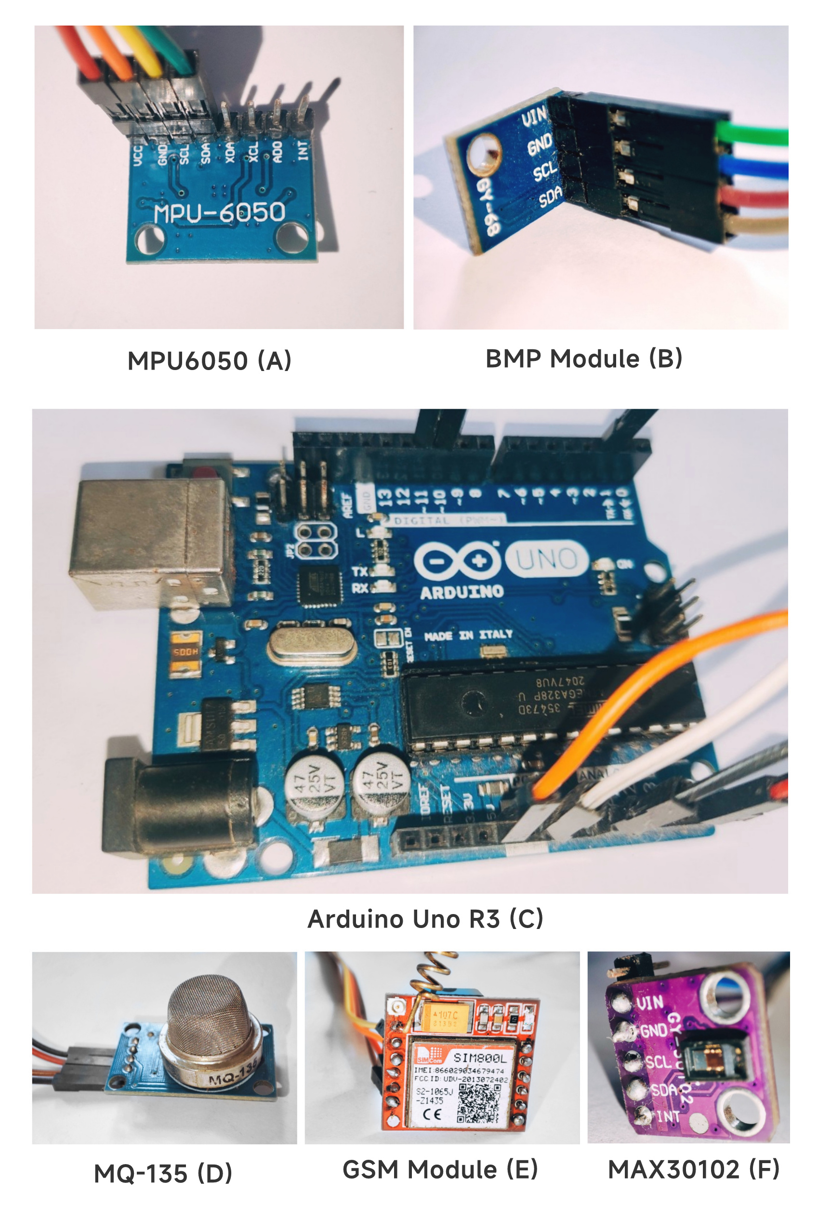
TOOLS AND TECHNOLOGIES
The proposed system consists of a processing device(Arduino Uno), a communication device (GSM module) alongside with 4 sensors, those are –
Accelerometer (MPU6050)
Gas (MQ135)
Barometric pressure(BMP-180)
Heart rate (MAX30102)

Slide 16
DATA COLLECTION
Designed prototype system relies on sensor based environmental information. Each sensor provides some certain types of real-time data.
Acceleration (3-axis), Angular rotation
Accelerometer sensor
Barometric pressure sensor
Temperature (nature), Pressure, Altitude, Humidity
Heart rate sensor
Gas sensor
Ammonia (NH3), Sulfur (S), Benzene (C6H6), CO2
Heart rate, Pulse oximeter, Temperature (body)

Slide 17
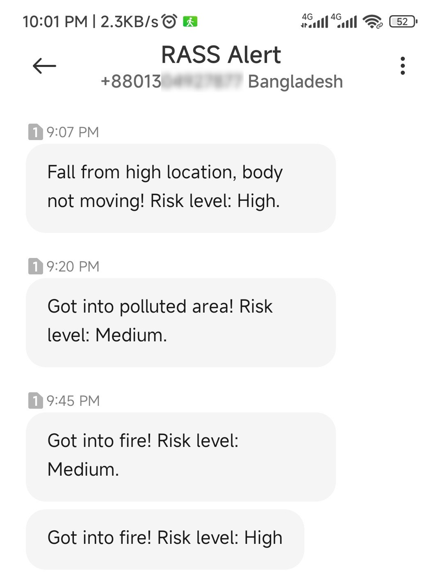
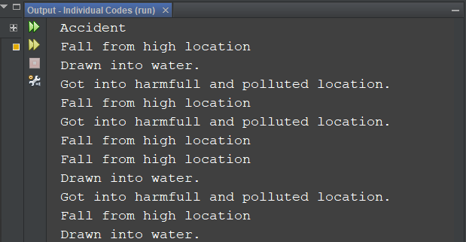
EVALUATION (cont.)
Test results of real-time sensor-data testing and virtually software-based testing.
Fig: test result with actual data
Fig: test result with virtually generated data

Slide 18
LIMITATIONS AND CHALLENGES
The system works as expected till now, but further evaluation may figure out more defects.
However some drawbacks found yet are –
Differentiating risky events vs regular events.
Limited risk detection.
Testing is hard and risky.
Failure propagation.
Hart rate sensor is not capable enough.

Slide 19
CONCLUSION
ASD child problems and barriers
Availability and high capability of IoT devices
Risk analysis and acknowledgement systems
Multi situation catch up and communication
Software evaluation resulted better than hardware
Hard to test

Slide 20
REFERENCES
[1] A. S. Agnal, S. Janani, C. Maneesha and K. Ramya “Autism Support System using RFID Technology,” Int. J. Engineering and Advanced Technology, vol. 9, no. 1, pp. 4706-4710, 2019.
[2] N. M. Abdullah and A. F. A. Allaf, “A support system for autistic children using Internet of Things technology,” 2021 Int. Conf. Advanced Computer Applications (ACA), pp. 51-56, 2021.
[3] K. Lavanya, S. M. Anitha, J. Joveka, R. Priyatharshni and S. Mahipal, “Emotion recognition of autism children using IoT,” Int. J. Applied Engineering Research, vol. 14, no. 6, pp. 106-111, 2019.
[4] S. Dedgaonkar, R. K. S. Bedi, K. Kothari, R. Loya and S. Godbole,“Role of IoT and ML for autistic people,” Int. J. Future Generation Communication and Networking, vol. 13, no. 3, pp. 773–781, 2019.

